Slide 1
Preservation Collaboration:
NDLTD & MetaArchive Cooperative
Gail McMillan
Digital Library and Archives, Virginia Tech
Newcomers’ Workshop @ ETDs 2010
University of Texas at Austin
Notes:
Thank you very much for inviting me to Ottawa and for this opportunity to share my enthusiasm for ETDs and their preservation.
Version 6/2/10 1:30pm

Slide 2
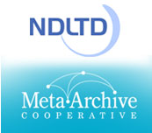
NDLTD/MetaArchive Alliance
ETD Preservation Survey
Dec. 2007-April 2008
95 institutions responded
80% have ETDs
27% have a preservation plan
92% interested in the
NDLTD preservation strategy
Notes:
We used an online survey to gauge the digital library community’s interest in an ETD-specific archive.
We learned that 80% of the survey respondents accept ETDS at their institutions and 40% of those institutions accept only electronic versions. HOWEVER, only ¼ had preservation plans, which means that a huge percentage (73%) do NOT have formal preservation plans. I found this shocking.
So not only did we have a good idea and a good strategy, we could meet a very broad need among institutions with electronic theses and dissertations.

Slide 3
What is Digital Preservation?
Systematic management of digital works over an indefinite period of time
  Processes and activities that ensure the continued access to works in digital formats
  Requires ongoing attention--constant input of resources: effort, time, money
Notes:
How can we preserve our ETD Collections and protect them from neglect--the “sands of time”, protect them from catastrophic events like fires and hurricanes, or hardware and software failures, or simple human error? We can implement pragmatic and affordable preservation strategies that exist today.
Consciously and systematically managing our digital works over an indefinite period of time is the definition of digital preservation that I’m using.
And MetaArchive Cooperative offers a preservation strategy and it is both affordable and easy to implement and maintain. But before going into the process and sample workflow, I want to clarify a few things.

Slide 4
Backups ≠ Digital Preservation
Backups are tactical measures
  Make copies to restore originals after data loss event.
  Typically stored in a single location
    Often nearby
    Collocated with the servers backed up
Backups address short-term data loss with minimal investment resources
Notes:
Backups are not the same as preservation. Backups are tactical measures [actions to reach a specific and near term end]--we make regular copies (usually over-writing previous copies), and keep them handy to restore following a data-loss event. But 30% of all archives have been backed up only one time or not at all according to the 2005 Northeast Document Conservation Center Survey by Bishoff and Clareson.
Preservation is a strategic goal to a long term outcome, and the means to achieve that goal. Backups are designed to address short-term data loss via minimal investment of money and staff resources. Backups are a good thing, but are not a comprehensive solution to the problem of preserving information over time.
Yes, many of our institutions are satisfied with backups, and VT was until we helped create a practical preservation option in 2003 through our work with the MetaArchive Cooperative.
An IR is also not a preservation strategy. They are largely a centralized approach aimed at managing information flow within an institution.

Slide 5
Digital Preservation is Strategic
Long-term, error-free storage and for the entire time span the information is required.
Realistically address issues in preserving information over time
  Ongoing investment
  Geographically dispersed set of secure caches
  Multi-institutional collaboration
DDPN: Distributed Digital Preservation Network
Notes:
Digital Preservation is Strategic. Preserving information over long periods requires systematic attention, not benign neglect like we can get sometimes away with like books on our library shelves.
To realistically address the issues involved in preserving ETDs over time, a true digital preservation program requires
Geographically dispersed set of secure caches AND
Some ongoing investment
Therefore, a Distributed Digital Preservation Network (DDPN) is most effective like the
MetaArchive Cooperative, which is a “community-owned, community-led initiative comprised of libraries, archives, and other cultural memory organizations. Using a technical framework that is based on the LOCKSS (Lots of Copies Keep Stuff Safe) software, members contribute digital collections into a geographically distributed network where they are mutually mirrored and refreshed on secure file servers in multiple locations.” [MetaA Content Policy]
The MetaArchive Cooperative is a distributed "dark archive" digital preservation option.

Slide 6
ETD Preservation Network is
Secure
  PLN: Private LOCKSS Network
  Reduces the likelihood that any single cache will be compromised
Distributed Geographically
  Reduces likelihood that loss of any single cache will lead to loss of the preserved information.
  A single organization is unlikely to have the capability to operate several geographically dispersed and securely maintained servers.
  Inter-institutional agreements will ensure commitment to act in concert over time.
Notes:
A Distributed Digital Preservation Network mobilizes efforts of multiple institutions. It entails a geographically dispersed set of secure caches which isn’t something a single institution is likely to have. A true digital preservation program will require multi-institutional collaboration and at least some ongoing investment to realistically address the issues involved in preserving information over time.
A PLN is a peer-to-peer system of geographically distributed servers running LOCKSS, as its main application. With this application computer programs are running in the background without human intervention, that among other things poll each other about content, vote on the content to determine its integrity, and when necessary restoring damaged content.
This approach offers Security to reduce the likelihood that any single cache will be compromised, AND Distribution reduces the likelihood that the loss of any single cache will lead to a loss of the preserved content.
But even Shared Archiving will fail without a precoordinated DDP Network in Place. It is well known that much of the cost in preserving digital material is in coordinating the organizational and institutional imperatives for preservation, and not the technological costs. [Library of Congress [NDIIPP] Archive Ingest and Handling Test (AIHT)]
But even if this is a good idea, how can our institutions possibly implement such a strategy?

Slide 7
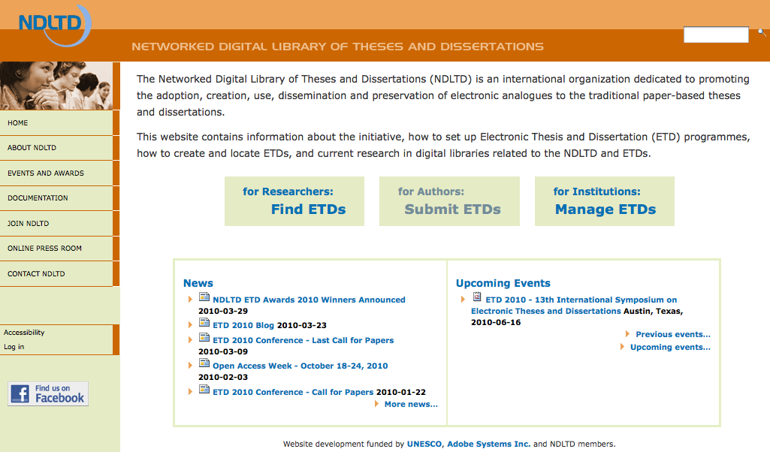
http://www.ndltd.org
Notes:
By joining and supporting organizations like the NDLTD, whose mission includes promoting the preservation of ETDs. To address this goal
The NDLTD created a strategic alliance with

Slide 8
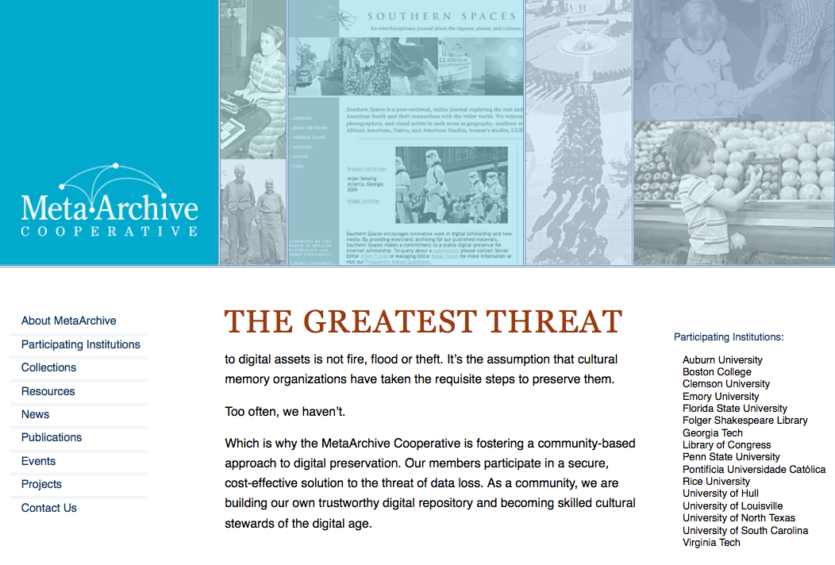
http://www.metaarchive.org
Notes:
with the MetaArchive Cooperative, which began as 6 research universities in the southeastern United States but has grown in a few years to 16 institutions in the US, UK, and Brazil. We share the concern that the digital items that define our culture and history might be forever lost due to disaster, error, or neglect, if we don’t do something and do it together—cooperatively, not individually.
We have a Charter, which is a formal agreement that lays out the members’ roles and responsibilities. We’ve each signed a Membership Agreement., in which we agree to preserve each others content for a specified period, and we pledge to not intentionally harm the network.
TRAC: Trusted Repositories Audit and Certification. The MetaArchive’s distributed digital preservation network conforms to all 84 criteria and operates according to the standards of a trusted digital repository.

Slide 9
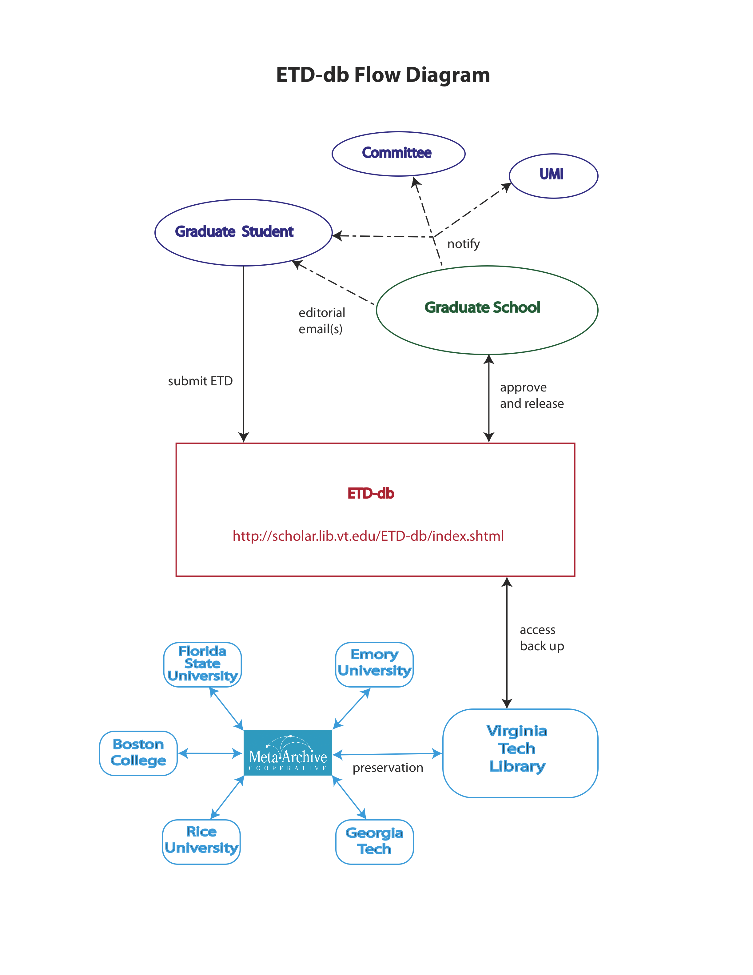
Notes:
Here is a sample workflow from the Graduate Student submitting an ETD through Graduate School approval and ingest into the Distributed Digital Preservation Network.
Here is a practical option
LOCKSS open source software from Stanford University is used differently because user access and preservation are separated in the secure and private ETD preservation network.
What is also especially important in both uses of LOCKSS, is the auditing feature—all files in the networked preservation caches are continually verified. Programmatic polling compares files and replaces bad files with good ones.

Slide 10
Notes:
This slide presents another take on workflow from the LOCKSS/MetaArchive perspective.
Note (1) that all ETDs, no matter their level of access from their home institutions, can be ingested and preserved by the MetaArchive, and (2) that recovery has been well tested—in both controlled and unplanned settings.
Programmatically harvest ETDs from host universities (LOCKSS)
Secure access: only authorized partners’ servers
Distributes content among partners
International digital preservation network
Standard hardware, free software
Audits and repairs content from partners as needed
Low cost to administer and run
Dark Archive only
http://scholar.lib.vt.edu/theses/NDLTD/NDLTDPreservationPlan2010.pdf

Slide 11
MetaArchive and ETD Preservation
Recovery: plan for it; don’t put off for another day
Collaboration: everybody participates and everybody benefits
Contact: Gail McMillan gailmac@vt.edu
Notes:
Let me leave you with these 3 suggestions:
Prepare your preservation strategy now.
If you separate community access from preservation, you’ll realize the advantages of focusing on the best strategy for each.
In a Cooperative with mutual goals and strategies we can affordably achieve more together than we can separately.
I think the advantages of using LOCKSS as the MetaArchive has to create and manage a dark archive of ETDs is the best and most affordable solution available today, and I hope you will take advantage of it.
Thank you for this opportunity to share my enthusiasm for ETDs and preservation.

